Slide 1
Design: Class Diagrams to Entity Relationship Diagrams
Class Diagrams - programmers
noun
a set or category of things having some property or attribute (data) in common and differentiated from others by kind, type, or relationships.
Entity Relationship Diagram (ERD) – database engineers
An entity relationship diagram (ERD), also known as an entity relationship model, is a graphical representation that depicts relationships among people, objects, places, concepts or events within an information technology (IT) system.

Slide 2
What are Entities?
17.3
Design Entities are classes whose design specifications have been completed to such a degree that they can be drafted for implemented in a Development Toolset.
The ERD helps the developer to progress onto the process of actual implementing the tables in a databse
Why are the entities (class objects) included in the UML?
The Entities (class objects) that are included in the UML are what represent the building blocks of the same objects or things.
Customer things? User things?
Order things? Sales things?
Basket things?
Despatch things?
This is the reason why the ERD are also referred to as the building blocks of a Database.
When it comes to the varying elements in the ERDs, there are a few we needs to be highlight and considered ….

Slide 3
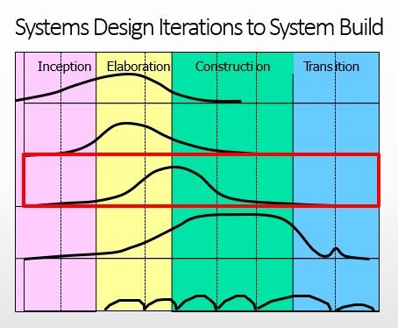
Design – ERD
16.2
Defn: In software engineering, a ERD in the UML is a type of static structure diagram that describes the structure of a system by showing the system's classes, their attributes, operations (or methods), and the relationships among objects.
SME: How best to view ‘Entities (Class – Objects)’
Things we need to model and build
Entity - Class Objects, Data and Sequence Operations?
Customer class – data and its sequences?
Order class – data and its sequences?
Etc
Entity - Class, Objects, Entities or Things we need to model & build in a SQL Server Database
Store and Server Related Data via technology such as SQL Server
Weeks 6-12 – Design (class – ERD) and Build in SQL Server Database
Things which need to be develop in Web/Mobile App Development Technology
YR2 MS Visual Studio or MS PowerApps - Both connect seamlessly to SQL Server.
Web/App Pages & Forms used to present Related Data from the Database

Slide 4






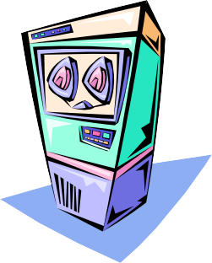

Sources of design Entities (classes)
17.3
Problem domain
Analysis classes
Design classes
Solution domain
Class Objects (Entitles or Things)
Customers
Orders (Basket)
OrderedProducts
Products
java.util

Slide 5
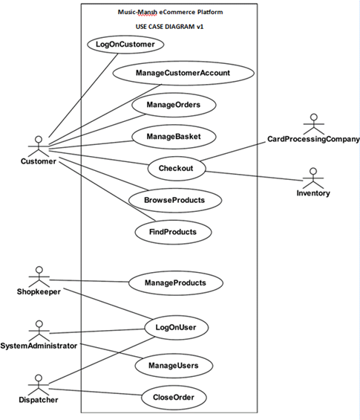
What are the Entities, class or objects or things we can identify from our Use Case
Do we need to record a list of the above in a Database? YES
Can we identify the class or object with a unique key? YES
Can we identify Class, Object, Entity or Thing identified by name or noun? YES
If YES then list the classes of interest for Team discussion.
Class Objects (Entitles or Things)
Customers?
Orders?
Basket?
OrderedProducts?
Products?
Users?
Class: Customer

Slide 6
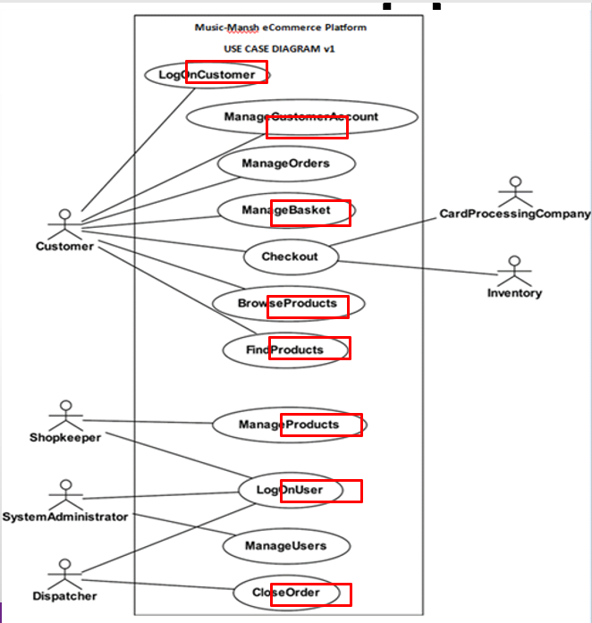
From weeks 3 & 4: identifying from Use Case and Sequence Diagrams our Class Object Entity or Things
Class Objects (Entitles or Things)
Customers
Orders
Basket
Products
Users
We may choose a main sequence to follow from the class or object prospective.
Focus on communication paths such as:
Customer adding items to a basket and placing an order.
Customer making a payment (needs to interact with Bank system). Customer has an Account?
Users login
We can map many Classes but focus on the common ones first.

Slide 7

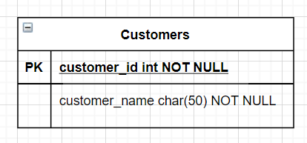
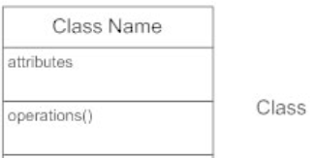
Basic Entity Diagram Symbols and Notations
Entities
Entity represent an abstraction of class, (things or objects) with common characteristics.
Associations represent the relationships between classes.
Illustrate classes with rectangles divided into compartments.
Place the name of the entity in the first partition (centered, bolded, and capitalized),
List the attributes in the second partition (left-aligned, not bolded, and lowercase)
We do not write operations as we do in Class Diagrams.
Class Objects (Entitles or Things)
Customers
Orders
Basket
Products
Users

Slide 8
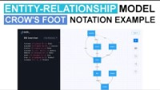
How to Developing ERDs: https://app.gleek.io/
UML Entity-Relationship model: Crow's foot notation example

Slide 9
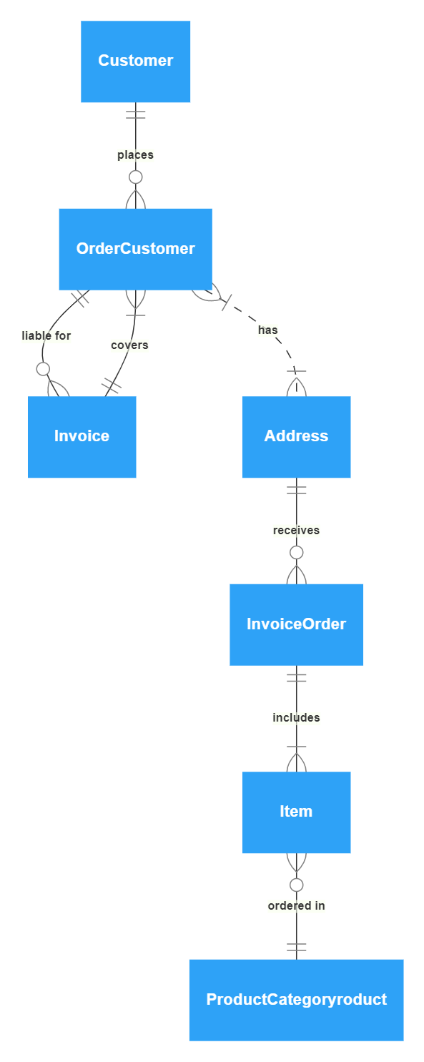
Gleek – ERDs: https://app.gleek.io/
Simple order process diagram code in Gleek: Live Demo
Simple gleek order example
Customer {1}- places-{0..n} Order Customer {1}-liable for -{0..n} Invoice {1}-covers-{1..n} Order Customer {1..n}-. has .-{1..n} Address {1}-receives-{0..n} Invoice Order {1}-includes-{1..n} Item {0..n}-ordered in-{1} Product Category {1}–{1..n}Product

Slide 10
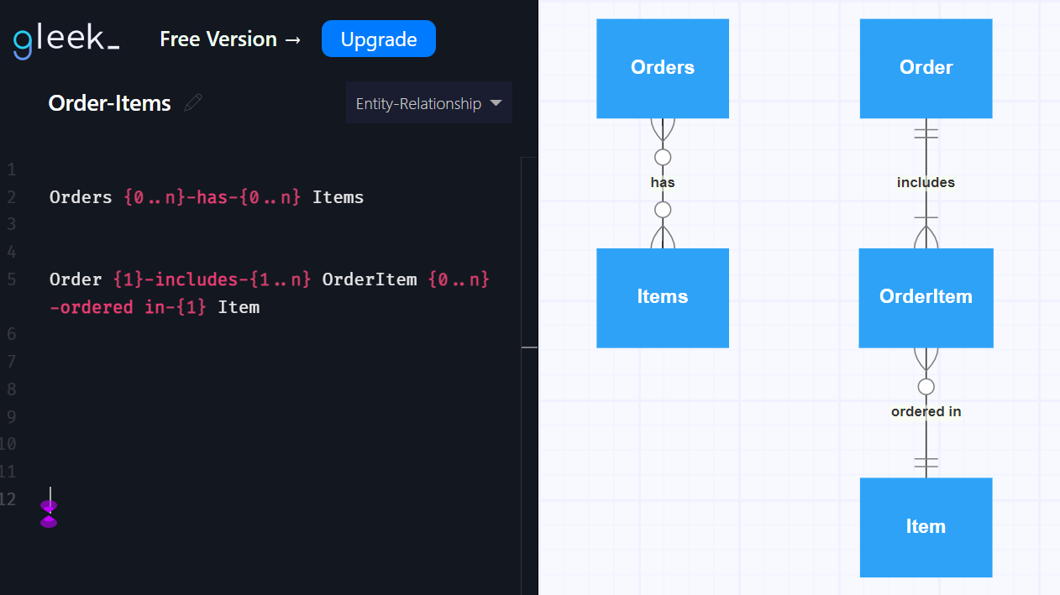
Gleek – ERDs: https://app.gleek.io/
eCommerce – ordered-items
Orders {0..n}-has-{0..n} Items
Order {1}-includes-{1..n} OrderItem {0..n}-ordered in-{1} Item
many to many
Always decompose to
1:m and m:1
And merge the 2 entity (class) names for a new entity type!
This is what the process of Normalisation and Entity Relationship modelling is all about.
Relational Databases can only handle
0,1:m relationships

Slide 11
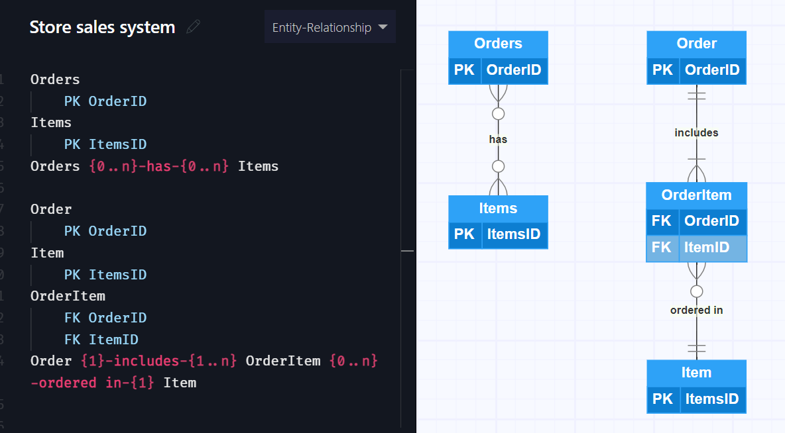
Gleek – ERDs: https://app.gleek.io/
eCommerce – ordered-items
Orders
PK OrderID
Items
PK ItemsID
Orders {0..n}-has-{0..n} Items
Order
PK OrderID
Item
PK ItemsID
OrderItem
FK OrderID
FK ItemID
Order {1}-includes-{1..n} OrderItem {0..n}-ordered in-{1} Item

Slide 12
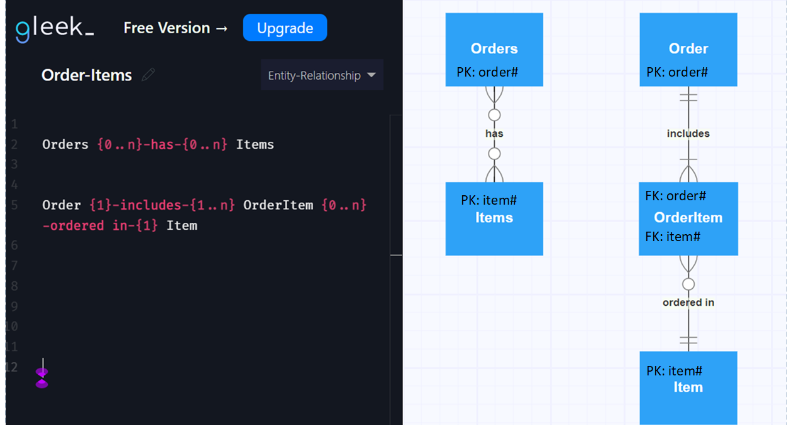
Gleek – ERDs: https://app.gleek.io/
eCommerce – ordered-items
Orders {0..n}-has-{0..n} Items
Order {1}-includes-{1..n} OrderItem {0..n}-ordered in-{1} Item
many to many: always decompose to
1:m and m:1
You merge the 2 entity (class) names and create a new entity type!
This is what the process of Normalisation and Entity Relationship modelling is all about.
A primary key PK from the one table transposes into the many table as a foreign key FK

Slide 13
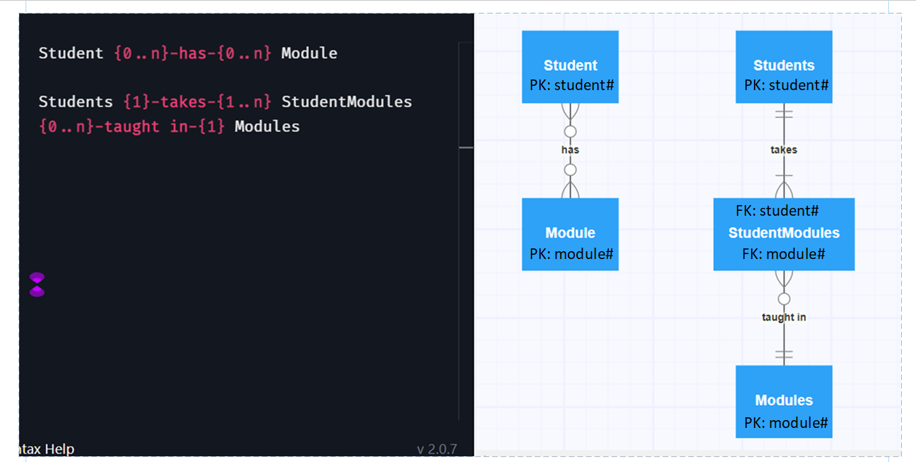
Gleek – ERDs: https://app.gleek.io/
eLearning Platform – student - modules
Student {0..n}-has-{0..n} Module
Students {1}-takes-{1..n} StudentModules {0..n}-taught in-{1} Modules
many to many: always decompose to
1:m and m:1
You merge the 2 entity (class) names and create a new entity type!
This is what the process of Normalisation and Entity Relationship modelling is all about.
A primary key PK from the one table transposes into the many table as a foreign key FK
Note gleek does not allow comments so I have added the primary keys in MS Publisher to demonstrate how the PK transposes from the 1 to the many table!

Slide 14
Gleek – ERDs: https://app.gleek.io/
Simple order process diagram code in Gleek: Live Demo
eCommerce – customer order example
Customer {1}- places-{0..n} Order {1}-liable for -{0..n}
Customer {1}-liable for -{0..n} Invoice {1}-covers-{1..n} Order
Customer {1}-liable for -{0..n} Despatch {1}-covers-{1..n} Order
Order {1}-includes-{1..n} OrderItem {0..n}-ordered in-{1} Item

Slide 15
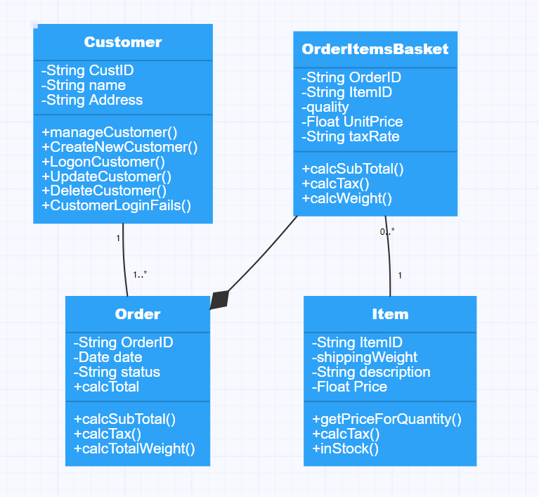

The ERD and Class Diagram We still map the same associations or relationships
one customer will have none, one or more orders.
one order must be associated to only one customer.
An order can have many items
An item can be on many orders
Many to many are mapped into a new class to map the Primary Keys OrderedItem.
Our Class Diagram introduces OrderItemsBasket
aka OrderItems or OrderLine.
Many to Many M:N always decompose into 2 x 1:m
Covered weeks 6 under ERD
Customer {1}--{1..*} Order
Order <*>-- OrderItemsBasket {1..*}--{1} Item

Slide 16
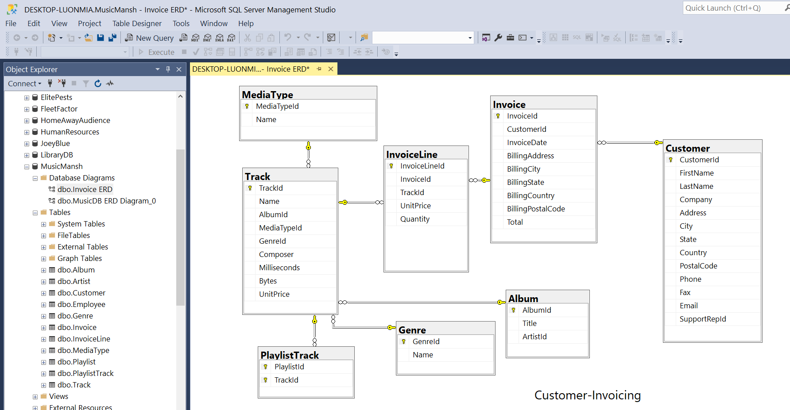
Weeks 6 : SQL Demo in prep for weeks 7 SQL Labs
SQL Labs start week 7

Slide 17
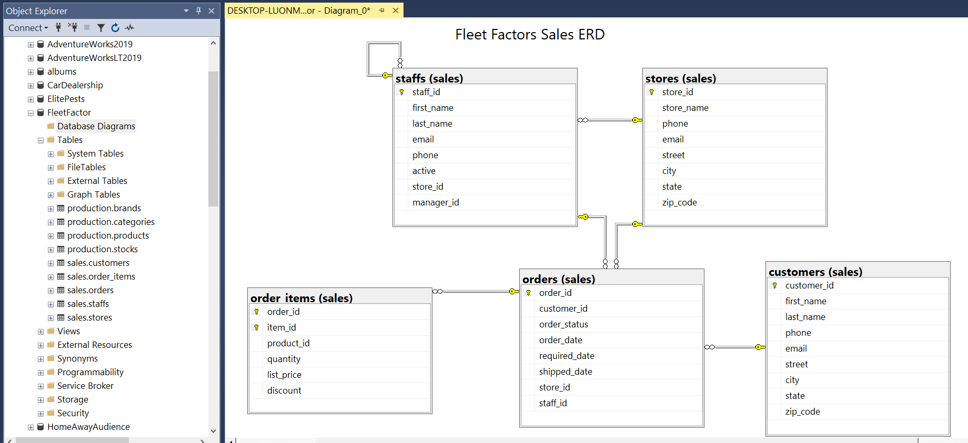
Weeks 6-10: Preview: eCommerce SQL solution for Fleet Factors

Slide 18
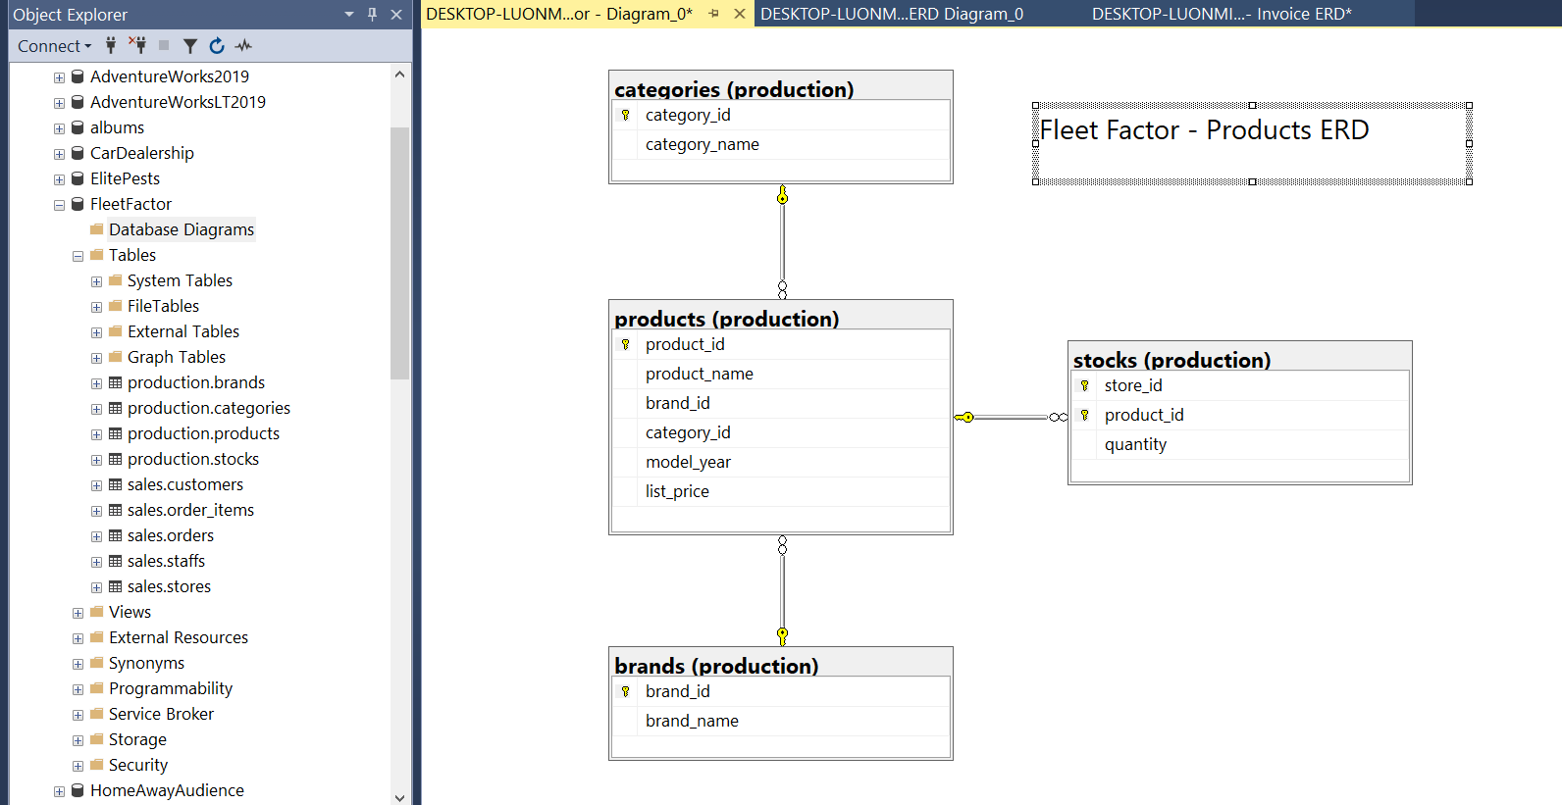
Preview: eCommerce SQL solution for Fleet Factors

Slide 19
End of Lecture

